Slide 1
FIRM RESUME
nowcfo.com | 844-858-6236

Slide 2
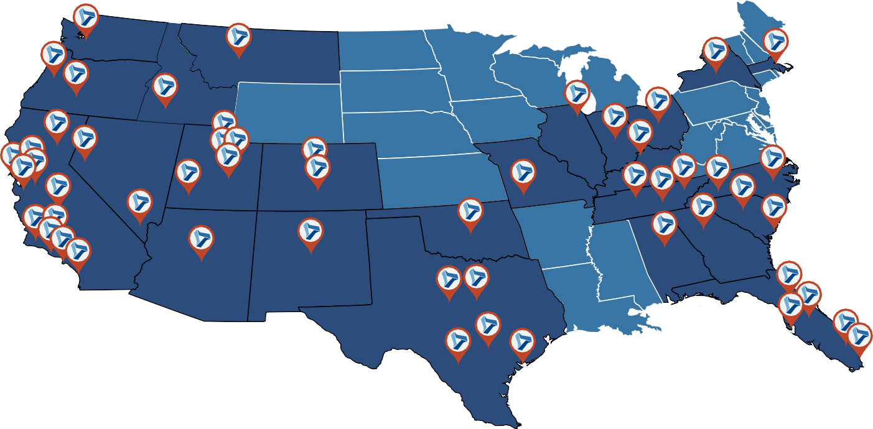
OFFICE LOCATIONS
Office Locations
On-site
Remote Work
Albuquerque, NM Atlanta, GA Austin, TX
Bend, OR Birmingham, AL Boise, ID
Cedar City, UT Charleston, SC Charlotte, NC Chattanooga, TN Chicago, IL
Colorado Springs, CO Columbia, SC
Columbus, OH Dallas, TX Denver, CO
Fort Lauderdale, FL Fort Worth, TX Fresno, CA
Helena, MT Houston, TX Indianapolis, IN Jacksonville, FL Knoxville, TN Las Vegas, NV Long Beach, CA
Los Angeles, CA Louisville, KY Miami, FL Nashville, TN Newport Beach, CA New York, NY Oakland, CA Ogden, UT Oklahoma City, OK Orlando, FL Phoenix, AZ Portland, OR
Provo, UT
Raleigh/Durham, NC Reno, CA Sacramento, CA
Salt Lake City, UT San Antonio, TX San Bernardino, CA San Diego, CA
San Francisco, CA San Jose, CA Seattle, WA Springfield, MO Tampa, FL Walnut Creek, CA

Slide 3
INDUSTRY EXPERTISE
M&A | Healthcare | Technology | Manufacturing
Life Sciences | Business Services | Real Estate | Automotive
ERP Systems | Agriculture | Consumer Products | Infrastructure
Nonprofits | Entertainment | Retail | Food & Beverage
Construction | Hospitality | Telecom | Energy

Slide 4
Financial Visibility
=
Smarter Business Decisions
Financial Data Must Be:
Accurate
Timely
Relevant
Insightful

Slide 5
WE DO THE DIRTY WORK
Fractional CFO
Strategy
Modeling & Forecasting Capital Raise
Exit Strategy
Mergers & Acquisitions Governance & Compliance Compensation Modeling
Outsourced Controller
Analysis
Cash Flow Forecasting Month-End Close
Financial Visibility /Dashboards Budgeting
Audit Preparation
Internal Controls /Processes Financial Reporting Packages Systems Conversion /Implementation
Staff Accountant
Execution
Bank Reconciliation Journal Entries
GL Maintenance Chart of Accounts Accounts Payable Accounts Receivable

Slide 6
OUR SERVICES
Outsourced/ Interim CFO Services
NOW CFO provides expertise in finance and CFO functions. We offer
in-depth operational, strategic, and funding transaction experience. We maximize the value of our services by matching the appropriate level resource with the appropriate task.
Controller Services
An experienced Controller is essential to the successful growth of any company. Our extensive experience gained from a multitude of companies and industries ensures that you have a capable resource
that will provide your company with unmatched excellence in financial reporting. We provide the results, information, and visibility required to make better financial decisions.
Our accounting supervisors and staff accountants are an integral part of our client services approach. This team carries the same goal as our outsourced CFOs and Controllers: your growth and success. Our firm provides affordable expertise targeting your specific business needs. They are well versed in multiple accounting systems including QuickBooks, MS Dynamics, NetSuite, SAP, Hyperion, Sage, Navision, and many more systems.
Our professionals provide expertise in cost accounting in order to quantify the cost associated with any type of operation. We have vast experience in job costing, Excess and Obsolescence analysis, Lower of Cost or Market analysis, and multiple inventory systems and methodologies.
Accounting Supervisor and Staff
Cost Accountants

Slide 7
OUR SERVICES
Audit Preparation
Audit preparation services include all aspects of preparing for your audit. These services typically include drafting financial statements and footnotes, preparing audit schedules, interfacing with auditors, and educating personnel on audit deliverables.
M&A Services
NOW CFO provides a wide range of pre- and post- M&A accounting services. Our expert consultants can assist with all due diligence related efforts (buyer and seller) before and during a sale. Additionally, post-acquisition integration services provide for a seamless transition to give the transaction the best chance of success.
Accounting Projects
Special one-time, lingering, and critical analysis projects can be readily completed by consultants with the specific experience needed.
SEC Services
NOW CFO SEC reporting managers have the experience and expertise in financial reporting necessary for public issuers. Our reporting managers are efficient and skilled at producing accurate financial statements in a timely manner to satisfy all SEC requirements.
Placements
Since it’s inception, NOW CFO has been placing employees for top companies by using advanced techniques that look beyond a resume.
We have access to a wide range of top talent and are experienced in finding and vetting the best candidates for the position. Our operational experts recognize what is crucial for the roles you need
filled and are well-versed in approaching candidates that are the right fit for your organization.

Slide 8
WE HAVE TRUSTED RELATIONSHIPS
We Are Here To Help
Banking
Insurance
Marketing
IT Services
Investors
CPA Firms
Attorneys
Payroll Providers
Merchant Services
Accounting Systems

Slide 9
REMOTE ACCOUNTING SERVICES
Accounting & Tax Services For Your Small Business
Bookkeeping
Monthly Book Closing
Provide Monthly Financial Statements
Tax Services
Prepare an Accurate Form & Maximize Tax Return
Organized Documentation Year Long
Accounts Receivable
Preparing & Sending Invoices
Collections
Bank & Credit Card Transactions
Transaction Coding
Daily, Weekly or Monthly Reconciliations
Accounts Payable
Enter Bills & Monitor Due Dates
Payment Processing
Payroll Transmission
Transmission to Provider
Maintain Employee Records

Slide 10
PLACEMENTS
We Look Beyond the Resume
NOW CFO has years of experience placing employees for top companies using advanced techniques
We vet top candidates across a range of industries with skills associated with accounting, finance, and back office positions.
NOW CFO is not an employment agency.
Discount savings between 7-10% under market costs.
Streamlined 30-day process to find your candidate.
We do the dirty work and narrow it down to the top talent.
Your new hire will be prepared to step into their position.
Collaborate with a dedicated staffing development representative and a recruitment specialist.
We will find the right person for the job at a fair price while delivering high-touch, high-value service.

Slide 11
MERGERS & ACQUISITIONS
Buyer
Seller
Due diligence experts
Verify source documentation
Accurate report of target’s financial condition
Understand financial position and minimize your risk
Integrate accounting after the acquisition
Build an efficient and accurate data room
Accurate financial statements and supporting source documents
Unbiased sounding board
Intermediary between you, the attorneys and accountants

Slide 12
THE COMPANY WE KEEP
All product and company names are trademarks™ or registered® trademarks of their respective holders. Use of them does not imply any affiliation with or endorsement by them.

Slide 13
THE COMPANY WE KEEP
All product and company names are trademarks™ or registered® trademarks of their respective holders. Use of them does not imply any affiliation with or endorsement by them.

Slide 14
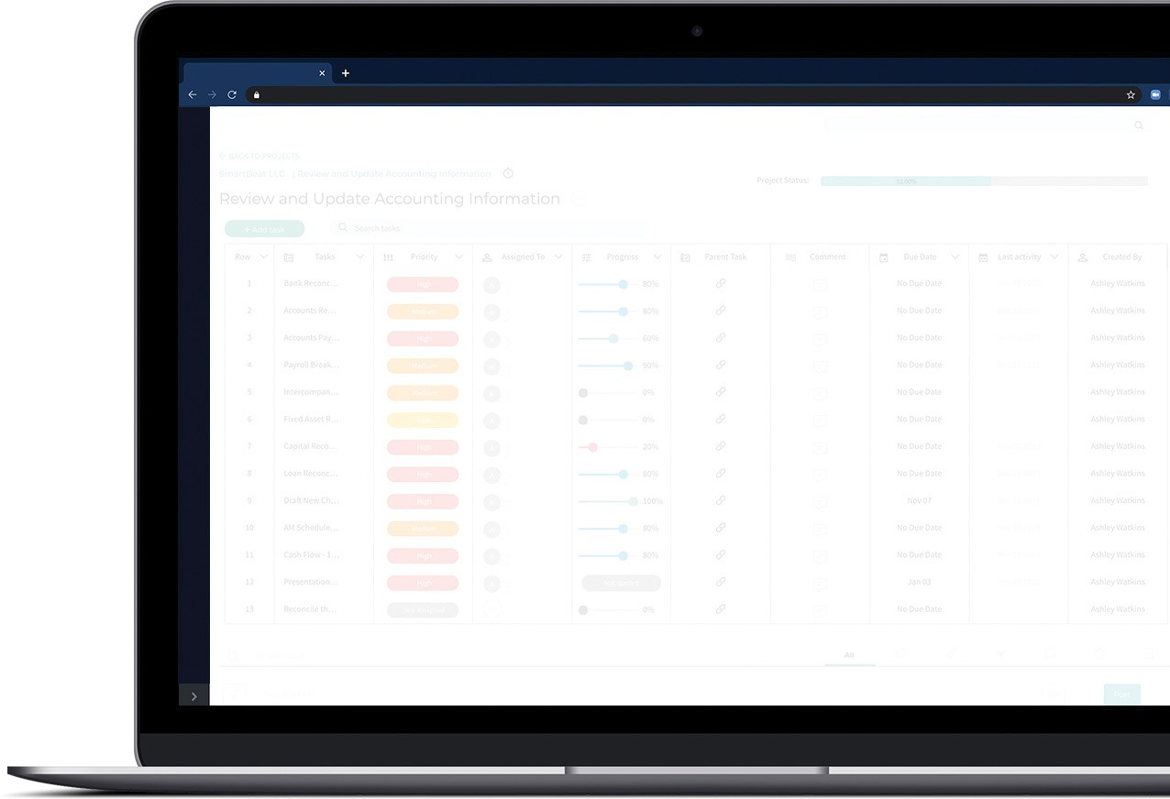
BIZVUE
Transparency is just a few clicks away
Up-to-Date Project Visibility
Notifications & Messaging
Client & Team Collaboration Trackable Project Status Constant Communication Detailed Time Tracking

Slide 15
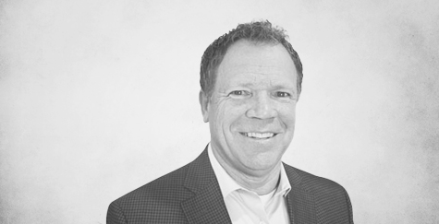
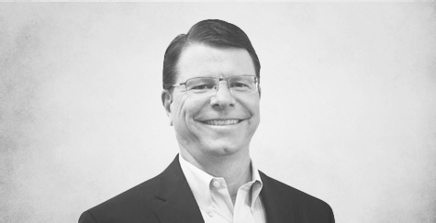
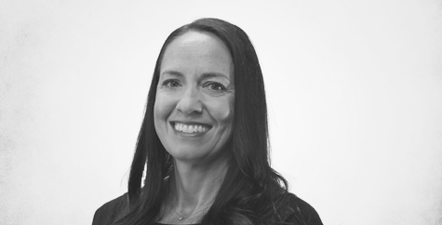
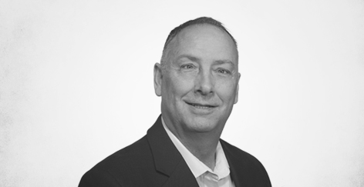
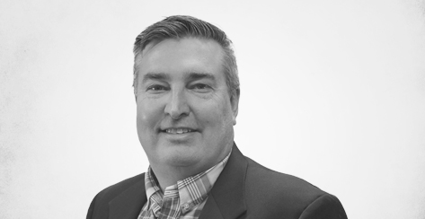
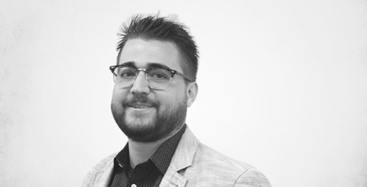
NATIONAL EXECUTIVE TEAM
Randy Christensen President & CEO rchristensen@nowcfo.com
Jim Bennett Chairman & Founder jbennett@nowcfo.com
Christina Jackson
Chief People Officer
christina.jackson@nowcfo.com
Jeff Gibbs
Chief Technology Officer
jgibbs@nowcfo.com
Shawn Dinkelman
Chief Financial Officer
shawn.dinkelman@nowcfo.com
Bodi Braithwaite
Field Chief Operating Officer
bbraithwaite@nowcfo.com

Slide 16
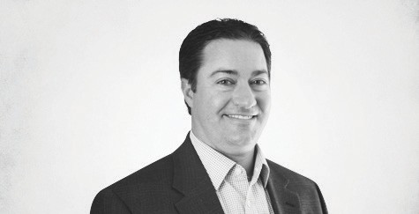
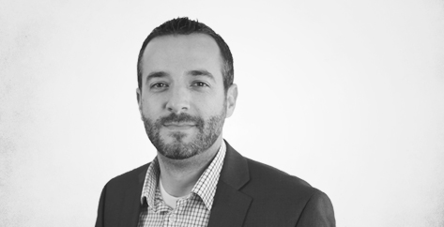
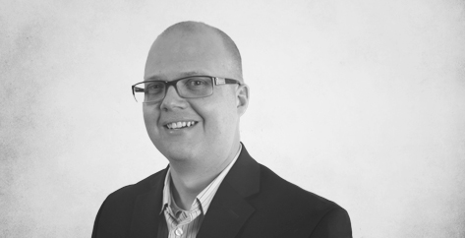
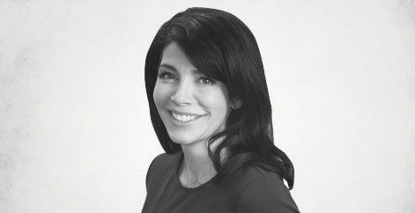
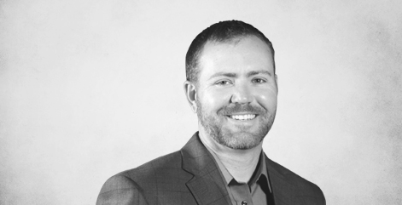
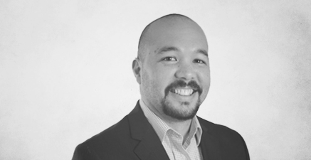
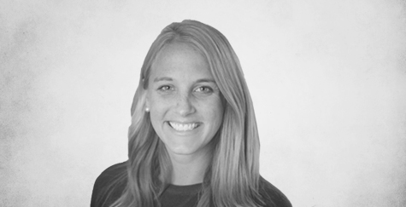
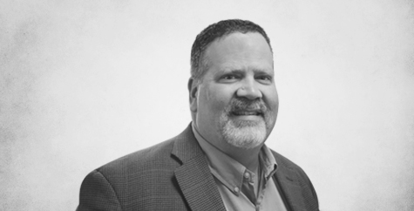
MARKET LEADERSHIP TEAM
Cole Dennard
Regional Partner Texas / Southeast
303-981-3473 | cdennard@nowcfo.com
Cole Dennard joined NOW CFO in 2009 and is the Regional Partner over the Texas and southeastern markets. He has extensive experience providing CFO-level
services in the oil and gas, manufacturing, technology, and professional industries. Cole earned his master’s degree in accounting from Texas Tech University and maintains an active CPA license.
TJ Delight
Regional Partner Southern California
949-945-6342 | tdelight@nowcfo.com
TJ Delight joined NOW CFO in 2009 and is the Regional Partner over the southern California markets. TJ provides CFO-level solutions to public and private companies within a broad range of industries. He earned a Master of Science degree in accountancy from Weber State University and maintains an active CPA license.
Kris Peterson
Regional Partner
Portland / Seattle / Northern California
971-201-0412 | kpeterson@nowcfo.com
Kris Peterson joined NOW CFO in 2011 and acts as Regional Partner over the Seattle, Portland, and northern California offices. Kris provides expert services in mergers and acquisitions, financial modeling and projections, capital raise, and accounting integration. He holds a Master of Science degree in accounting and maintains an active CPA license.
Marianne Allison
Regional Partner
Nevada / Arizona / New Mexico
702-278-4951 | mallison@nowcfo.com
Marianne Allison joined NOW CFO in 2019 and serves as Regional Partner over
Nevada, Arizona and New Mexico markets. She brings extensive knowledge of internal control development, forecasting, and complex modeling. She holds a Bachelor of Science degree in accounting from
the University of South Alabama and maintains an active CPA license.
Eric Patrick
Regional Partner Tennessee / Ohio / Indiana
615-878-1508 | epatrick@nowcfo.com
Erick Patrick joined NOW CFO in 2017 and serves as Regional Partner over the Tennessee, Ohio, and Indiana markets. He brings CFO experience from the manufacturing, technology, non-profit, and agriculture industries. Eric holds a Master of Science degree in accounting from Rhodes College and maintains an active CPA license.
Bill Sablan
Partner Seattle, WA
206-225-2253 | bsablan@nowcfo.com
Bill Sablan joined NOW CFO in 2013 and serves as Partner of the Seattle market. His specialties include helping companies establish a solid accounting foundation and better understand their financial needs.
He holds a bachelor’s degree in business administration with a concentration in accounting from Cal Poly, San Luis Obispo and maintains an active CPA license.
Mariah Block
Partner
San Diego, CA
858-922-8985 | mblock@nowcfo.com
Mariah Block joined NOW CFO in 2015 and serves as Managing Partner in San Diego, California. Mariah brings her business development experience, organizational skills, and strategic mindset to her clients. She works with a diverse client base within the biotech and manufacturing industries. She has a bachelor’s degree in business from California Lutheran University.
Chris Badger
Partner
Salt Lake City, UT
801-598-9390 | cbadger@nowcfo.com
Chris Badger joined NOW CFO in 2014 and acts as Partner of the Salt Lake City market. Chris is a senior accounting professional who brings broad industry
and technical accounting experience to his clients. He holds an MBA from the Keller Graduate School of Business.

Slide 17
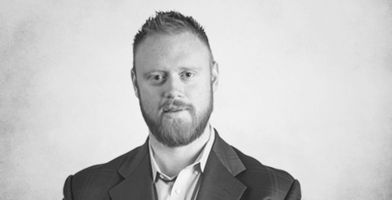
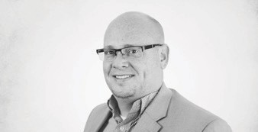
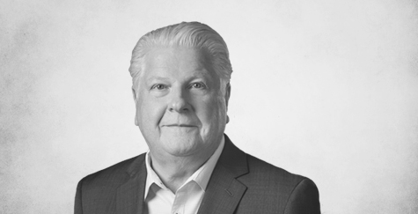
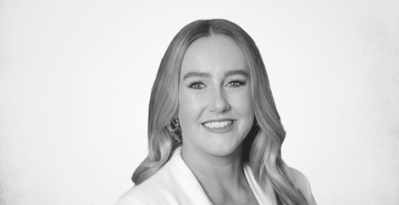
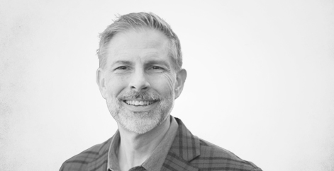
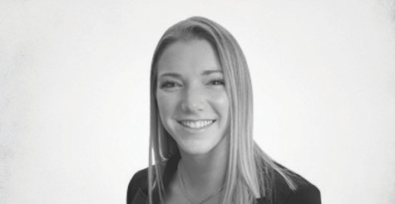
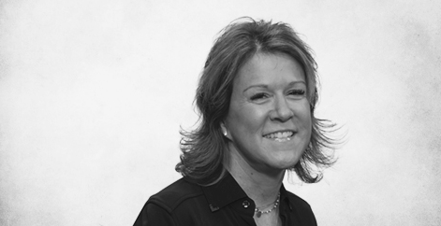
MARKET LEADERSHIP TEAM
John Curtin
Partner
Los Angeles, CA
562-907-8444 | jcurtin@nowcfo.com
John Curtin joined NOW CFO in 2020 and serves as Partner in the Los Angeles market. He brings extensive experience in finance, accounting, consulting, implementing ERP systems, and raising start-up capital. He holds a bachelor’s degree in business administration and accounting from Biola University.
Sana Sundrani
Partner
Dallas / Fort Worth, TX
214-493-7539 | ssundrani@nowcfo.com
Sana Sundrani joined NOW CFO in 2014 and is the Partner over the Dallas and Fort Worth offices. Sana’s experience allows her to think about each business from a holistic perspective and tailor solutions that fit into the framework and vision of each client. She graduated from Baylor University in 2013.
Brit Summerill
Partner
Silicon Valley, CA
669-225-0207 | bsummerill@nowcfo.com
Brit Summerill joined NOW CFO in 2012 and is the Partner over the San Francisco, San Jose, and Oakland offices. He provides CFO-level solutions that include cash flow
projections, financial analysis, SEC reporting, and complex equity, debt, and derivative accounting. He holds a master’s degree in accounting from Weber State University.
Kevin Clouser
Partner Boise, ID
208-590-0938 | kclouser@nowcfo.com
Kevin Clouser joined NOW CFO in 2019 and is the Partner of the Boise market. Kevin is an experienced business strategist and leader in corporate accounting, business operations, and financial management. He is a graduate of Purdue University and Indiana University’s Kelley School of Business.
Melissa Thorniley
Partner Columbus, OH
615-651-2671 | mthorniley@nowcfo.com
Melissa Thorniley joined NOW CFO in 2018 and serves as a Partner in Columbus, Ohio. She brings a passion for networking and connecting people to NOW CFO, and actively participates in a number
of professional networking groups. She holds a double major in accounting and finance from the University of North Alabama.
David Dechant
Market President South & North Carolina
864-238-0028 | david.dechant@nowcfo.com
David Dechant joined NOW CFO in 2021 and serves as Market President over offices in the Carolinas. He brings
CFO-level expertise from the technology, manufacturing, and consumer products industries. He holds a bachelor’s degree in accounting from Bob Jones University.
Rachel Durkot
Market President Phoenix, AZ
602-370-8662 | rdurkot@nowcfo.com
Rachel Durkot joined NOW CFO in 2018 and is the Market President over the Phoenix office. She brings managerial expertise
and a growth mindset to her clients, both of which have provide her to be an asset to the NOW CFO team. She holds a bachelor’s degree in marketing from Slippery Rock University of Pennsylvania.
Amy Farrow
Partner Indianapolis, IN
615-762-8175 | afarrow@nowcfo.com
Amy Farrow joined NOW CFO in 2019 and serves as Partner in the Indianapolis market. She graduated from Samford University with a Bachelor of Science degree in Business Administration with an emphasis in accounting. She brings extensive CFO- level experience to her clients, helping them to establish internal controls, develop budgets, analyze cash flow, and generate solutions to their challenges.

Slide 18
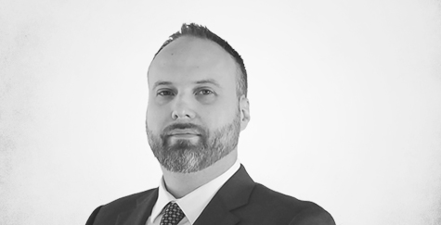
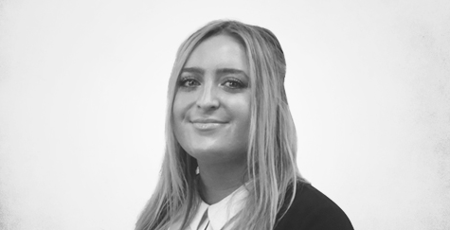
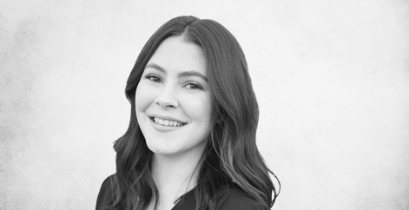
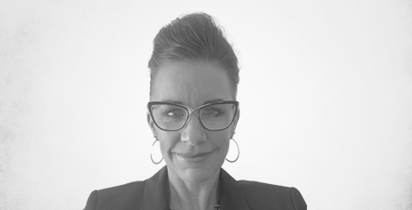
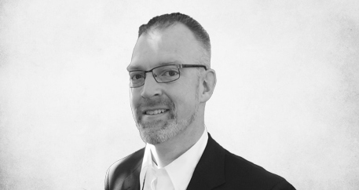
MARKET LEADERSHIP TEAM
Nate Sorensen
Partner
Salt Lake City, UT
801-616-7378 | nsorensen@nowcfo.com
Nate Sorensen joined NOW CFO in 2017 and is the Partner of the Salt Lake City market. His expertise includes
helping clients with complex accounting challenges and teaching them to utilize financial information to better operate their businesses. He holds an MBA from Utah State University.
Caroline Hébert
Market President Denver, CO
720-584-1104 | chebert@nowcfo.com
Caroline Hébert joined NOW CFO in 2019 and acts as Market President over the Colorado offices. She helps her clients identify solutions and maps strategic plans to help them achieve organizational goals. Caroline holds a bachelor’s degree from the University of Tennessee in business administration and human resource management.
Shelby Allmon
Market President Nashville, TN
865-599-2810 | sallmon@nowcfo.com
Shelby Allmon joined NOW CFO in January of 2020 in the Knoxville,
Tennessee market. Since then, Shelby has made the transition to serving our Nashville, Tennessee office as a Market President. Shelby graduated from the University of Tennessee, Knoxville in 2017, and later served as a regional sales leader in the cosmetics industry. Shelby brings valuable background in sales leadership to the NOW CFO team.
Hillary Rogers
Market President Tampa, FL
813-344-9405 | hrogers@nowcfo.com
Hillary Rogers joined NOW CFO in 2021 and acts as Market President of the Tampa office. Hillary brings a strong background in business development and possesses the ability to improve relationships while nurturing networking partners and clients. She earned a bachelor’s degree in public health from the University of South Florida.
Tiffaney Kolander
Market President Albuquerque, NM
720-376-8275 | tkolander@nowcfo.com
Tiffaney Kolander joined 2019 and is the Market President of the Albuquerque office. She is a results-driven CPA with an MBA in accounting and finance from Regis University. She offers success in leading financial management activities
at both public accounting and non-profit organizations.
Sam Howell
Market President Orlando, FL
801-750-4364 | samuel.howell@nowcfo.com
Sam Howell joined NOW CFO in 2021 and serves as Market President in the Orlando market. He is a enterprise-wide value partner with 15+ years of versatile experience in finance, accounting, auditing, and business management. He is an entrepreneurially driven, adaptive professional with a successful track record of business optimization and profitability growth, while building teams and scaling companies spanning across various industries.
Eleana Palomino
Market President South Florida
727-732-9654 | efrangedis@nowcfo.com
Eleana Frangedis joined NOW CFO in 2021 and serves as Market President over Fort Lauderdale. She graduated with her bachelor’s degree in Business
Administration, International Business, and Trade from Florida Atlantic University, and brings a background working with start- ups and an abundance mindset to her role.
April Diemer
Market President Atlanta, GA
470-889-1751 | april.diemer@nowcfo.com
April Diemer serves as the Market President of Atlanta, GA and brings a background of CFO-level experience in financial strategy, mergers, acquisitions, and investor relations from a diverse range of industries. She holds a bachelor’s degree in accounting from the University of South Florida.

Slide 19
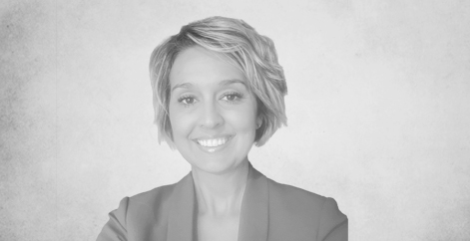
MARKET LEADERSHIP TEAM
Contact Us For
A Free Consultation
844-858-6236 | nowcfo.com/contact-us
William Langworthy
Market President San Bernardino, CA
951-348-8915 | wlangworthy@nowcfo.com
William Langworthy joined NOW CFO in 2021 and is Market President of the San Bernardino office. He comes from a
‘Big Four’ public accounting background and has extensive experience working with companies of varying industries and sizes. He holds a master’s degree
in professional accountancy from Biola University and is a licensed CPA.
Gain Financial Visibility Into Your Business
We provide outsourced, fractional, and temporary CFO, Controller, and Operational Accounting services that suit the needs of your business.
Hourly Rates No Hidden Fees
No Long Term Requirements
Tanesha Bundy
Market President Oklahoma City, OK
580-239-0436 | tanesha.bundy@nowcfo.com
Tanesha Bundy joined NOW CFO in 2022 and is the Market President in Oklahoma City. Tanesha has a strong background in hospitality, retail, and construction. Tanesha has a passion for bringing organization
and efficiency to her clients. She holds a master’s in accounting from University of Oklahoma.
NOW CFO provides the highest level of expertise in finance and operational accounting to accelerate results and achieve strategic objectives for sustainable growth and success.

Slide 20
nowcfo.com 844-858-6236
Q1 - 2023

