Slide 2
2005
Founded in Salt Lake City, UT
50+
Locations
WHO WE ARE
400+
Employees
The CFO Solution for Modern Businesses
150+
Accounting
Systems Expertise
15,000+
Happy Clients
30+
Industries Served

Slide 3
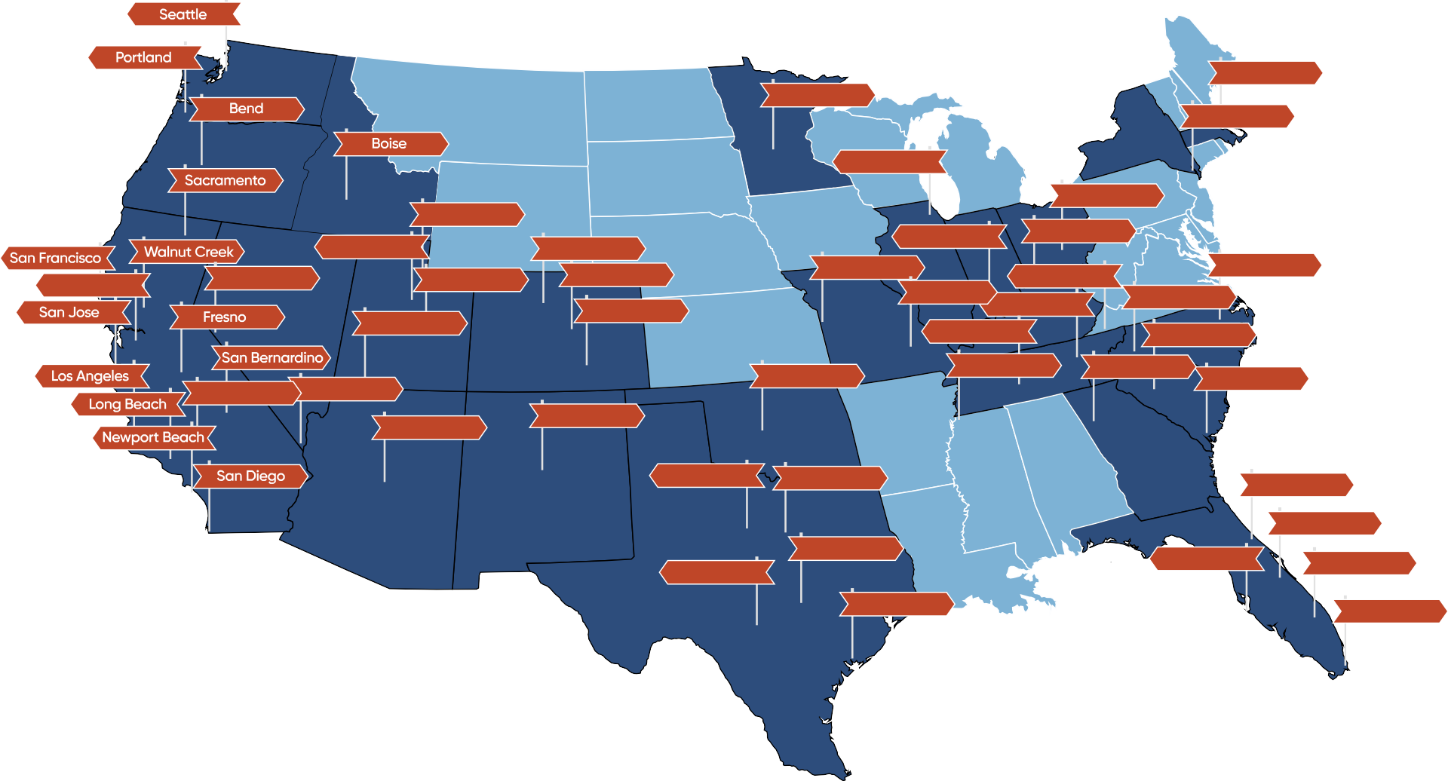
OUR LOCATIONS
Minneapolis
Boston
New York
Chicago
Ogden
Columbus
Salt Lake City
Boulder
Denver
Indianapolis
Louisville
Oakland
Reno
Provo
Kansas City
Knoxville Chattanooga
Raleigh
Colorado Springs
St. Louis
Charlotte
Cedar City
Nashville
Columbia
Las Vegas
Oklahoma City
Memphis
Atlanta
Charleston
Riverside
Albuquerque
Phoenix
Fort Worth
Dallas
Jacksonville
Orlando
San Antonio
Austin
Tampa
Fort Lauderdale
Houston
Miami

Slide 4
FINANCIAL VISIBILITY
=
SMARTER BUSINESS DECISIONS
Financial Data Must Be:
Accurate
Timely
Relevant
Insightful

Slide 5
INDUSTRY EXPERTISE
M&A
Healthcare
Technology
Manufacturing
Life Sciences
Business Services
Real Estate
Automotive
ERP Systems
Agriculture
Consumer Products
Infrastructure
Nonprofits
Entertainment
Retail
Food & Beverage
Construction
Hospitality
Telecom
Energy

Slide 6
OUTSOURCED EXPERTS
CFO
STRATEGY
CONTROLLER
ANALYSIS
STAFF ACCOUNTANT
EXECUTION
Modeling & Forecasting
Capital Raise Exit Strategy
Mergers & Acquisitions Governance & Compliance Compensation Modeling Audit Preparation
Cash Flow Forecasting
Month-End Close Financial Dashboards Budgeting
Internal Controls Financial Reporting Systems Implementation
Bank Reconciliation
Journal Entries GL Maintenance Chart of Accounts Accounts Payable
Accounts Receivable Inventory Management

Slide 7
CORE VALUES
PASSION
EXCELLENCE
GROWTH
COMMUNICATION
PROFESSIONALISM
DISCIPLINE
ACCOUNTABILITY
RELIABILITY

Slide 8
OUR SERVICES
We know the power of a strong accounting staff. We encourage our clients to take control of their business’ financial future with our experts by their side.
OPERATIONAL ACCOUNTING
AUDIT PREPARATION
SYSTEMS & SOFTWARE IMPLEMENTATION
Providing expertise and support for a wide range of accounting and finance-related projects including budgeting, cash
flow management, process improvement, financial modeling, and more to help make informed decisions that can help drive business growth and success.
Financial statements and other documentation must be prepared in advance of an external audit. These services ensure that financial statements are accurate, complete, and in compliance with applicable regulations and accounting standards.
Systems and software implementation services involve the design, implementation, and optimization of accounting and financial systems to improve accuracy in financial operations, streamline processes, and improve financial performance.

Slide 9
OUR SERVICES
Our team of professionals range from staff accountants up to Controllers and CFOs. We utilize our team of experts to find the best fit for your company’s needs. Whether your organization is a small start-up or a major corporation, NOW CFO is dedicated to delivering the results you are looking for.
MODELING
& FORECASTING
INTERNAL CONTROLS
ANNUAL OPERATING PLANS & FINANCIAL STRATEGIES
Financial and economic data is used to create projections and models to help businesses make informed decisions. This includes financial modeling, budgeting, forecasting, cash flow analysis, scenario planning, risk analysis, market analysis, and economic forecasting.
Services to provide businesses with the necessary tools
and strategies to maintain a strong and effective control environment, which can help prevent fraud, reduce risk, and improve operational efficiency.
An annual operating plan is a comprehensive roadmap for a company’s financial
activities, including goals, KPIs, and budgets, that helps them achieve clear objectives, allocate resources, measure performance, and make informed decisions.

Slide 10
REMOTE ACCOUNTING
OPENING THE DOOR TO MORE
Professional Accounting Services From Anywhere
A LARGER TALENT POOL
FLEXIBLE AND ADAPTABLE
TAILORED SERVICES
ACCOUNTABILITY
(CONTROLLER OVERSIGHT)
We provide quality control services with Controller- level oversight and project management.
VETTED RESOURCES
We have 20+ years of experience of systematically recruiting accounting roles, and our talent pool is readily available!
ENHANCED EFFICIENCY
We improve efficiency with BizVue, continuous training, SOP creations, & optimize time zones across the world.

Slide 11
REMOTE ACCOUNTING
Monthly Book Closing
Monthly Financial Statements
Small Business Accountants
Financial Analysis
Bill & Payment Processing
Invoicing & Collections
Expense Reporting
Vendor Invoice Verification
ACCOUNTING
AP & AR
Statements Reconciliation
Merchant Account Reconciliation
Transaction Coding
Invoice Reconciliation
Payroll Input & Data Validation
Transmission to Provider
Maintain Employee Records
Payroll Report Generation
RECONCILIATIONS
PAYROLL
OUR MOST POPULAR ACCOUNTING ROLES:
Chartered Accountant
Staff Accountant

Slide 12
MERGERS & ACQUISITIONS PREPARATION
Our focus is to create shareholder value with high quality, rigorous due diligence for your merger and acquisitions. Our consultants provide you with the right balance of functional, regional, industry expertise and resources on each of your deals.
BUYER SELLER
Due diligence experts
Verify source documentation
Accurate report of target’s financial condition
Understand financial position & minimize your risk
Integrate accounting after acquisition
Build an efficient & accurate data room
Accurate financial statements & supporting source documents
Unbiased sounding board
Intermediary between you, the attorneys & accountant
Valuation analysis

Slide 13
How We Work & Advantages of Outsourced Accounting
INTERIM
GAIN EXPERTISE
SAVE TIME & MONEY
HOURLY
ELIMINATE ERRORS
ENHANCE EFFICIENCY
PROJECT BASED
INCREASE PROFITABILITY

Slide 14
WE HAVE TRUSTED RELATIONSHIPS
CPA Firms | Attorneys | Banking | Investors | Insurance IT Services | Merchant Services | Payroll Providers
These partnerships enable us to provide our clients with a broader range of services and expertise. By leveraging these partners knowledge and resources, we offer a holistic approach to financial management and contribute even more to the success of our clients businesses.
Benefit Existing Clients
Grow Your Portfolio

Slide 15
PLACEMENT SERVICES
NOW CFO has years of experience placing employees for top companies using advanced techniques.
We distinguish ourself from competitors by utilizing a unique candidate selection process. We rely on our experienced team of CFOs to conduct rigorous technical interviews to assess candidates’ cultural fit as well as their high-level accounting expertise specific to the role they are seeking.
We screen skilled candidates for accounting, finance, and back office roles across various industries.
We offer discount savings between 7-10% under market costs.
Find your candidate with our streamlined 30-day process.
The newly recruited employee will be fully prepared to take on their assigned role.
You will be partnered with a recruitment specialist to get the best outcome.
We deliver high-value service by finding the right person for the job at a reasonable price.
We handle the hard work and narrow it down to the top talent.
14
*Disclaimer: NOW CFO is NOT an employment agency.
Private & Confidential © NOW CFO. All rights reserved. nowcfo.com

Slide 16
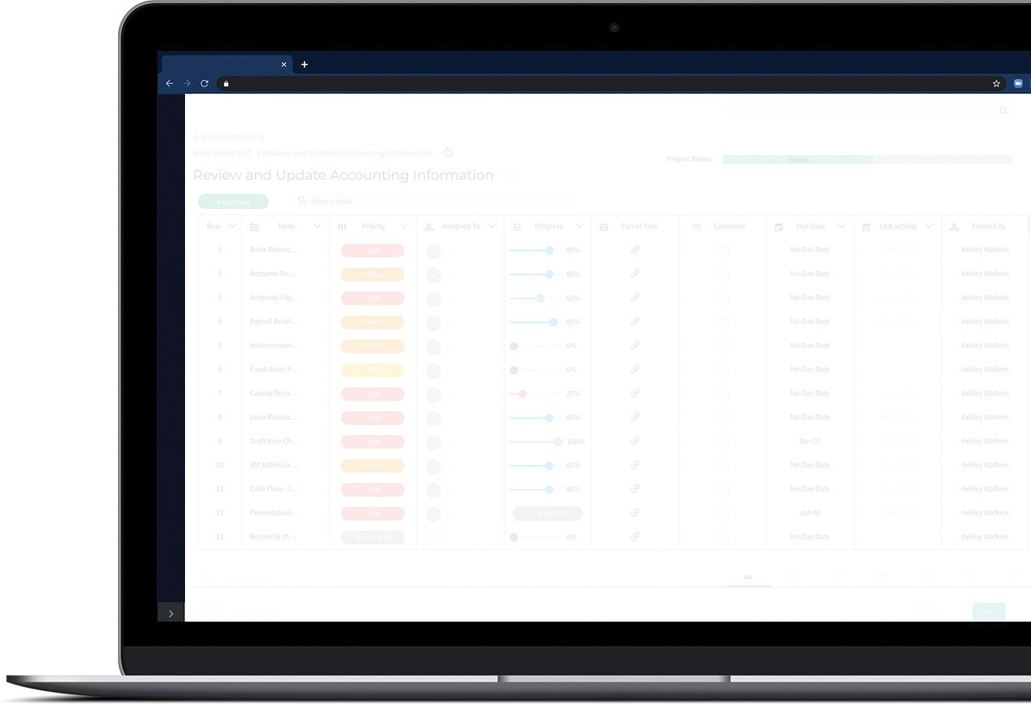
BIZVUE: BUSINESS COLLABORATION TOOL
As the ultimate business collaboration tool, BizVue allows you to easily keep track of all your projects and their associated time and expenses, plus invite your clients to collaborate on projects right in the same platform.
Transparency Is Just A Few Clicks Away
Up-to-Date Project Visibility Trackable Project Status Detailed Time Tracking Client & Team Collaboration Constant Communication Notifications & Messaging

Slide 17
BIZVUE SERVICES
An Unparalleled Level of Transparency and Collaboration
Capable but easy to use project management tools
Accurate invoices with time tracked to projects
PROJECT MANAGEMENT
PROJECT-BASED TIME TRACKING
Collaborate directly with team members
Flexible and scalable organization hierarchies
CLIENT MANAGEMENT
ORGANIZATIONAL MANAGEMENT

Slide 18
THE COMPANY WE KEEP
All product and company names are trademarks™ or registered® trademarks of their respective holders. Use of them does not imply any affiliation with or endorsement by them.

Slide 19
THE COMPANY WE KEEP
All product and company names are trademarks™ or registered® trademarks of their respective holders. Use of them does not imply any affiliation with or endorsement by them.

Slide 20
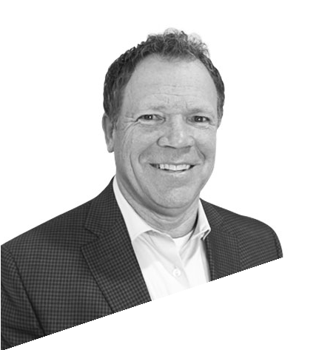
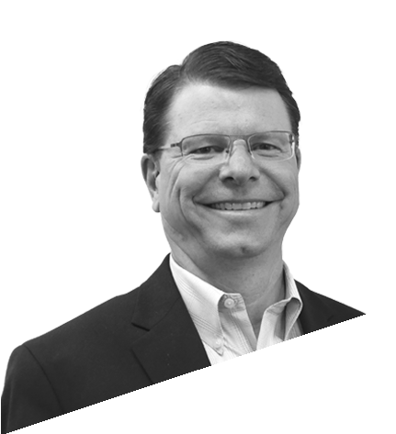
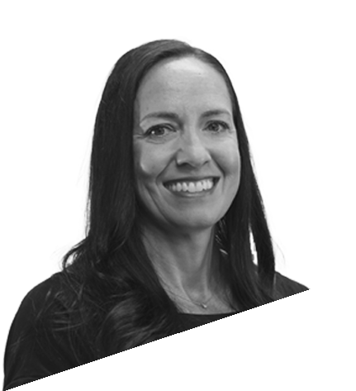
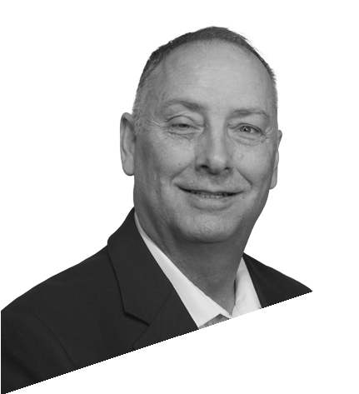
NATIONAL EXECUTIVE TEAM
RANDY CHRISTENSEN
PRESIDENT & CEO
rchristensen@nowcfo.com
JIM BENNETT
CHAIRMAN & FOUNDER
jbennett@nowcfo.com
CHRISTINA JACKSON
CHIEF PEOPLE OFFICER
christina.jackson@nowcfo.com
JEFF GIBBS
CHIEF INFORMATION OFFICER
jgibbs@nowcfo.com
SHAWN DINKELMAN
CHIEF FINANCIAL OFFICER
shawn.dinkelman@nowcfo.com

Slide 21
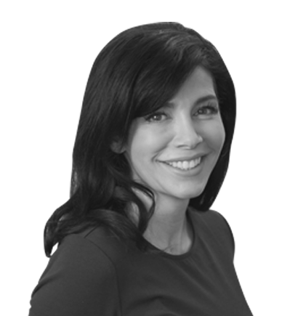
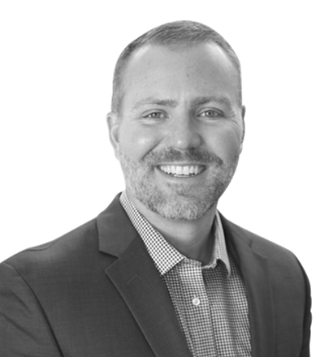
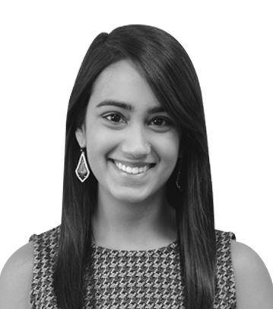
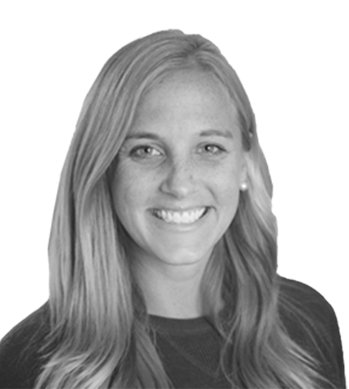
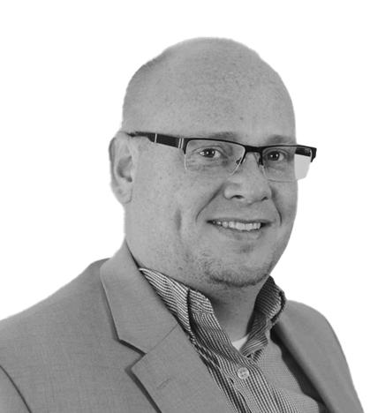
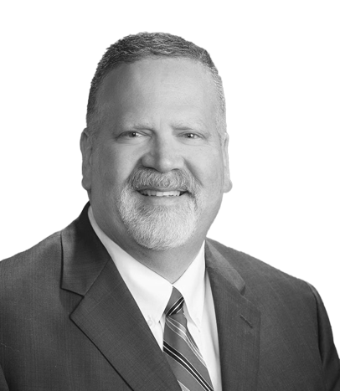
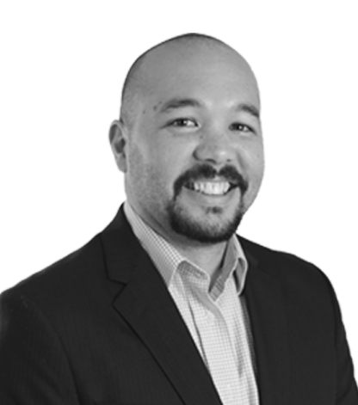
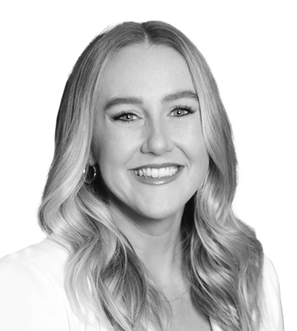
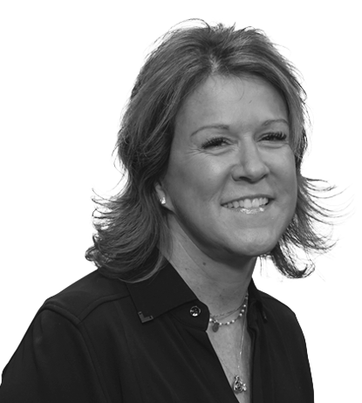
MARKET LEADERSHIP TEAM
COLE
DENNARD
REGIONAL PARTNER
Texas | Illinois | Oklahoma 303-981-3473
cdennard@nowcfo.com
MARIANNE
ALLISON
REGIONAL PARTNER
Nevada | Arizona |
New Mexico | So. California 702-278-4951
mallison@nowcfo.com
BODI
BRAITHWAITE
REGIONAL PARTNER
Colorado | Utah | Idaho 720-594-9064
bbraithwaite@nowcfo.com
ERIC
PATRICK
REGIONAL PARTNER
Tennessee | Ohio | Indiana | North & South Carolina
615-878-1508
epatrick@nowcfo.com
SANA
SUNDRANI
PARTNER
Dallas, TX | Chicago, IL 214-493-7539
ssundrani@nowcfo.com
MARIAH
BLOCK
PARTNER
San Diego, CA 858-922-8985
mblock@nowcfo.com
BRIT
SUMMERILL
PARTNER
Silicon Valley, CA 669-225-0207
bsummerill@nowcfo.com
CHRIS
BADGER
PARTNER
Salt Lake City, UT 801-598-9390
cbadger@nowcfo.com
SHELBY
ALLMON
MARKET PRESIDENT
Nashville, TN 865-599-2810
sallmon@nowcfo.com
BILL
SABLAN
PARTNER
Seattle, WA 206-225-2253
bsablan@nowcfo.com
MELISSA
HENKE
PARTNER
Columbus, OH 615-651-2671
mhenke@nowcfo.com
AMY
FARROW
PARTNER
Indianapolis, IN 615-762-8175
afarrow@nowcfo.com

Slide 22
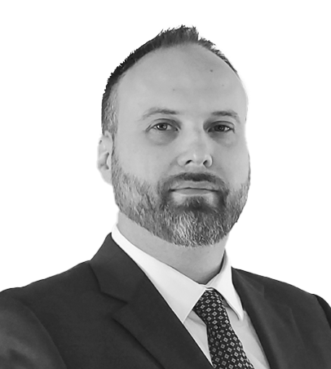
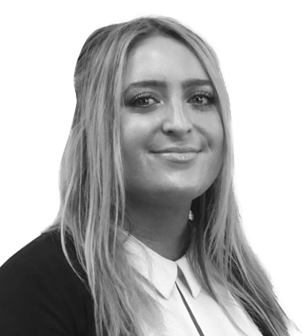
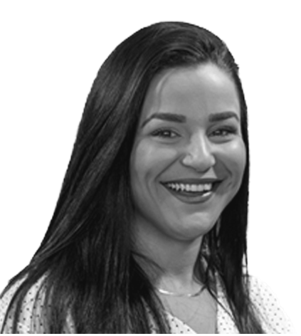
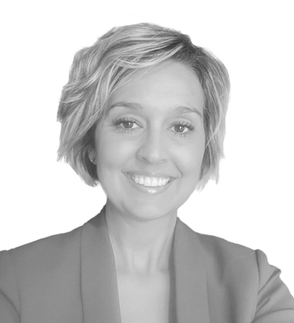
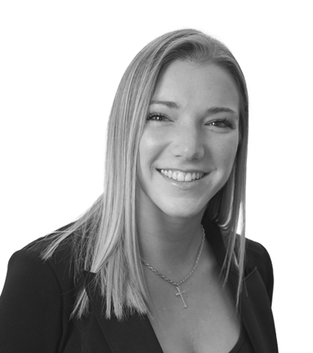
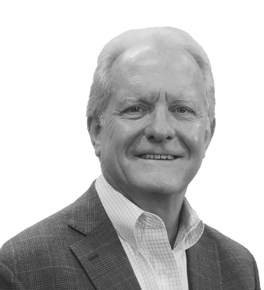
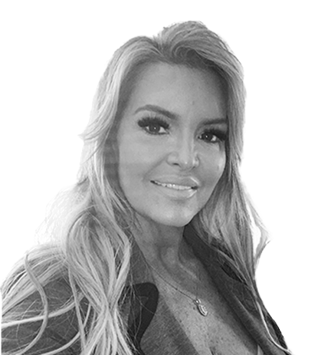
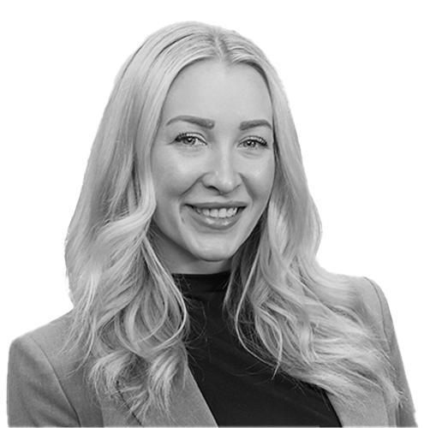
MARKET LEADERSHIP TEAM
NATE
SORENSEN
PARTNER
Salt Lake City, UT 801-616-7378
nsorensen@nowcfo.com
CHRISTI
CEREGHINO
PARTNER
Phoenix, AZ 702- 533- 6638
christi.cereghino@nowcfo.com
CAROLINE
HÉBERT
MARKET PRESIDENT
Denver, CO 720-584-1104
chebert@nowcfo.com
HILLARY
ROGERS
MARKET PRESIDENT
Tampa, FL 813-344-9405
hrogers@nowcfo.com
TANESHA
BUNDY
MARKET PRESIDENT
Oklahoma City, OK 580-239-0436
tanesha.bundy@nowcfo.com
RACHEL
DURKOT
MARKET PRESIDENT
Phoenix, AZ 602-370-8662
rdurkot@nowcfo.com
SAM
HOWELL
MARKET PRESIDENT
Orlando, FL 801-750-4364
samuel.howell@nowcfo.com
GEORGE
STEPHENS
MARKET PRESIDENT
Austin, TX 512-970-1432
george.stephens@nowcfo.com
WILLIAM
LANGWORTHY
MARKET PRESIDENT
Los Angeles & San Bernardino, CA 951-348-8915
wlangworthy@nowcfo.com
APRIL
DIEMER
MARKET PRESIDENT
Atlanta, GA 470-889-1751
april.diemer@nowcfo.com
SCOTT
CHRISTENSEN
MARKET PRESIDENT
Houston, TX 801-505-8203
scott.christensen@nowcfo.com
BASIL
CORNELL
MARKET PRESIDENT
Orlando, FL 407-250-7207
bcornell@nowcfo.com

Slide 23
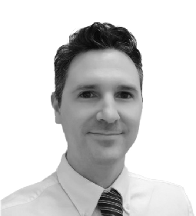
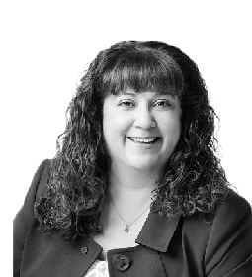
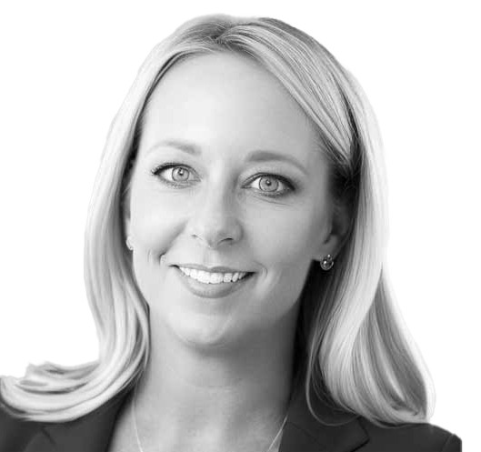
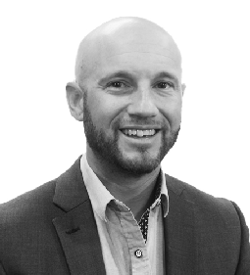
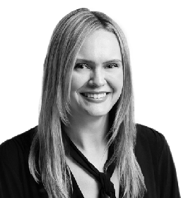
MARKET LEADERSHIP TEAM
JOSH
GUSTIN
MARKET PRESIDENT
Newport Beach, CA 949-531-0384
jgustin@nowcfo.com
DANA
WALLACE
MARKET PRESIDENT
Newport Beach, CA 949-922-6247
dwallace@nowcfo.com
KIMBERLY
ROCHA
MARKET PRESIDENT
Portland, OR 503-984-7876
krocha@nowcfo.com
BEN
GODINEZ
MARKET PRESIDENT
Sacramento, CA 916-956-0200
ben.godinez@nowcfo.com
TAYLOR
BECKMAN
MARKET PRESIDENT
Portland, OR 971-501-8148
taylor.beckman@nowcfo.com
NOW CFO - Your Trusted Financial Partner

Slide 24
Experience the Power of Outsourced Financial Expertise
Contact Us For A Free Consultation
nowcfo.com 844-858-6236

