Slide 1
nowcfo.com | 844-858-6236
FIRM RESUME
OUTSOURCED CFO, CONTROLLER, ACCOUNTING, AND FINANCE EXPERTS

Slide 2
2005
Founded in Salt Lake City, UT
50+
Locations
WHO WE ARE
400+
Employees
The CFO Solution for Modern Businesses
150+
Accounting
Systems Expertise
15,000+
Happy Clients
30+
Industries Served

Slide 3
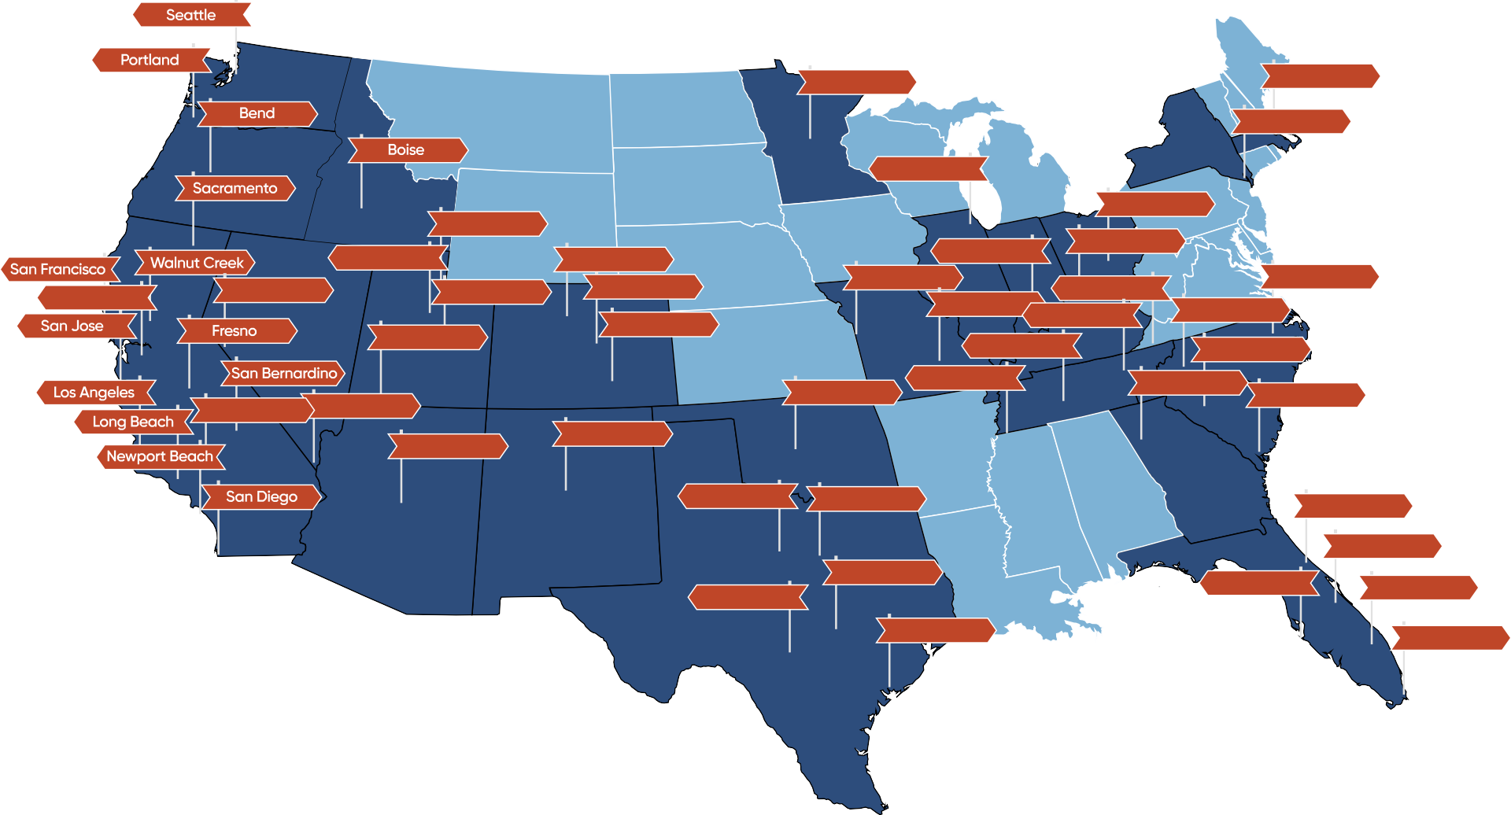
OUR LOCATIONS
Minneapolis
Boston
New York
Chicago
Ogden
Columbus
Salt Lake City
Boulder
Denver
Indianapolis
Louisville
Oakland
Reno
Provo
Kansas City
Knoxville Chattanooga
Raleigh
Colorado Springs
St. Louis
Charlotte
Cedar City
Nashville
Columbia
Oklahoma City
Memphis
Atlanta
Charleston
Riverside
Las Vegas
Phoenix
Albuquerque
Fort Worth
Dallas
Jacksonville
Orlando
San Antonio
Austin
Tampa
Fort Lauderdale
Houston
Miami

Slide 4
FINANCIAL
Financial Data Must Be:
VISIBILITY
=
Accurate
Timely
SMARTER BUSINESS
DECISIONS
Relevant
Insightful

Slide 5
INDUSTRY EXPERTISE
M&A
Healthcare
Technology
Manufacturing
Life Sciences
Business Services
Real Estate
Automotive
ERP Systems
Agriculture
Consumer Products
Infrastructure
Nonprofits
Entertainment
Retail
Food & Beverage
Construction
Hospitality
Telecom
Energy
4

Slide 6
OUTSOURCED EXPERTS
CFO
CONTROLLER
ANALYSIS
Cash Flow Forecasting Month-End Close Budgeting
Internal Controls Financial Dashboards Financial Reporting Systems Implementation
STAFF ACCOUNTANT
STRATEGY
EXECUTION
Modeling & Forecasting
Capital Raise Exit Strategy
Mergers & Acquisitions Governance & Compliance Compensation Modeling Audit Preparation
Bank Reconciliation
Journal Entries GL Maintenance Chart of Accounts Accounts Payable
Accounts Receivable Inventory Management
5
Private & Confidential © NOW CFO.. All rights reserved.. nowcfo.com

Slide 7
CORE VALUES
PASSION
EXCELLENCE
GROWTH
COMMUNICATION
PROFESSIONALISM
DISCIPLINE
ACCOUNTABILITY
RELIABILITY

Slide 8
OUR SERVICES
Business Accounting & Financial Statements:
Precise financial statement preparation to accurately reflect your business’s performance.
Internal Controls:
Implementation of internal control systems to safeguard assets and maintain financial integrity.
SEC Compliance & Reporting:
Expert guidance on SEC compliance and reporting, ensuring adherence to regulations.
Modeling & Forecasting:
Customized financial modeling and forecasting to support informed strategic decisions.
Annual Operating Plans & Financial Strategies:
Comprehensive annual budgets and financial strategies to align with your business objectives.
Staff Training:
Training designed to empower your team with essential financial skills and knowledge.

Slide 9
OUR SERVICES
Bookkeeping:
Expense tracking, invoicing, and account reconciliation to keep your financials accurate and up to date.
Audit Preparation:
Comprehensive audit preparation services to ensure a smooth and efficient audit process.
Inventory Management:
Inventory management solutions to streamline tracking and control costs.
M&A Preparation:
M&A support by preparing financials and managing due diligence.
Systems and Software Implementation:
Seamless integration and implementation of various accounting systems and software.
Accounting Clean-Up:
Accounting clean-up services to reorganize and correct your financial records.

Slide 10
REMOTE ACCOUNTING
Monthly Book Closing
Monthly Financial Statements
Small Business Accountants
Financial Analysis
Bill & Payment Processing
Invoicing & Collections
Expense Reporting
Vendor Invoice Verification
ACCOUNTING SERVICES,
FROM ANYWHERE
ACCOUNTING
AP & AR
A Larger Flexible Talent Pool & Adaptable
Tailored Services
ACCOUNTABILITY
(CONTROLLER OVERSIGHT)
Statements Reconciliation
Merchant Account Reconciliation
Transaction Coding
Invoice Reconciliation
Payroll Input & Data Validation
Transmission to Provider
Maintain Employee Records
Payroll Report Generation
RECONCILIATIONS
PAYROLL
We provide quality control services with Controller-level oversight and project management.
VETTED RESOURCES
We have 20+ years of experience of systematically recruiting accounting roles, and our talent pool is readily available.

Slide 11
ADVANTAGES
OF OUTSOURCED ACCOUNTING
FRACTIONAL
HOURLY
PROJECT BASED
Gain Expertise Save Time & Money Eliminate Errors Enhance Efficiency
Increase Profitability

Slide 12
WE HAVE TRUSTED RELATIONSHIPS
Benefit Existing Clients
Grow Your Portfolio
These partnerships enable us to provide our clients with a broader range of services and expertise. By leveraging these partners knowledge and resources, we offer a holistic
approach to financial management and contribute even more to the success of our clients businesses.
CPA Firms Attorneys Bankers Investors Insurance IT Services
Merchant Services Payroll Providers

Slide 13
PLACEMENT SERVICES
NOW CFO has years of experience placing employees for top companies using advanced techniques.
We distinguish ourself from competitors by utilizing a unique candidate selection process. We rely on our experienced team of CFOs to conduct rigorous technical interviews to assess candidates’ cultural fit as well as their high-level accounting expertise specific to the role they are seeking.
We screen skilled candidates for accounting, finance, and back office roles across various industries.
We offer discount savings between 7-10% under market costs.
Find your candidate with our streamlined 30-day process.
The newly recruited employee will be fully prepared to take on their assigned role.
You will be partnered with a recruitment specialist to get the best outcome.
We deliver high-value service by finding the right person for the job at a reasonable price.
12
*Disclaimer: NOW CFO is NOT an employment agency.
Private & Confidential © NOW CFO. All rights reserved. nowcfo.com

Slide 14
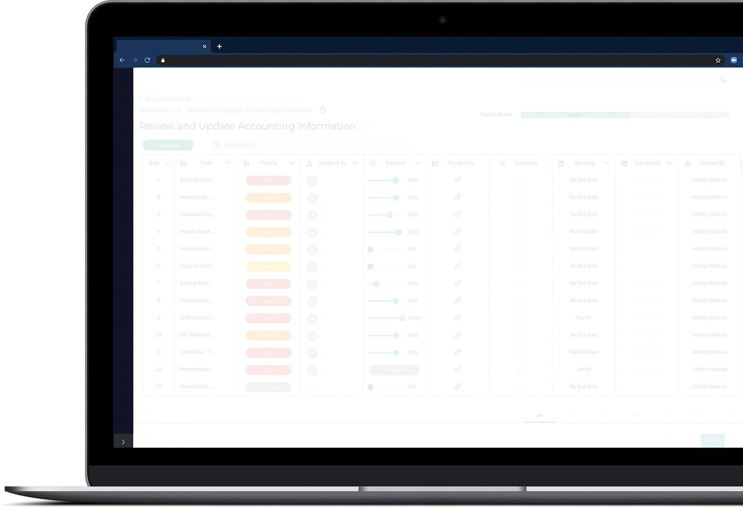
BIZVUE: BUSINESS COLLABORATION TOOL
As the ultimate business collaboration tool, BizVue allows you to easily keep track of all your projects and their associated time and expenses, plus invite your clients to collaborate on projects right in the same platform.
Transparency Is Just A Few Clicks Away
Up-to-Date Project Visibility Trackable Project Status Detailed Time Tracking Client & Team Collaboration Constant Communication Notifications & Messaging

Slide 15
BIZVUE SERVICES
An Unparalleled Level of Transparency and Collaboration
Capable but easy to use project management tools
Accurate invoices with time tracked projects
PROJECT MANAGEMENT
PROJECT-BASED TRACKING
Collaborate directly with team members
Flexible and scalable organization hierarchies
CLIENT MANAGEMENT
ORGANIZATIONAL MANAGEMENT

Slide 16
THE COMPANY WE KEEP
All product and company names are trademarks™ or registered® trademarks of their respective holders. Use of them does not imply any affiliation with or endorsement by them.

Slide 17
THE COMPANY WE KEEP
All product and company names are trademarks™ or registered® trademarks of their respective holders. Use of them does not imply any affiliation with or endorsement by them.

Slide 18
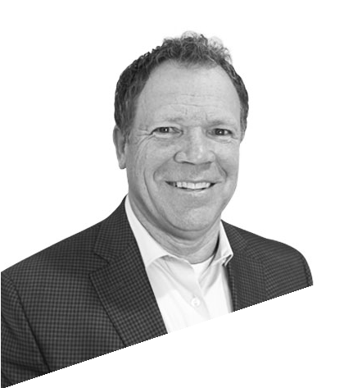
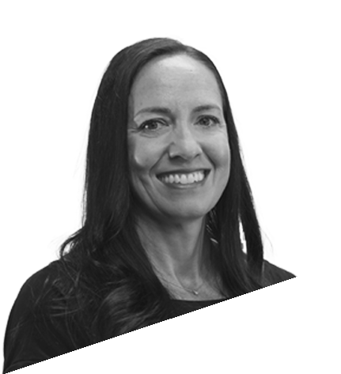
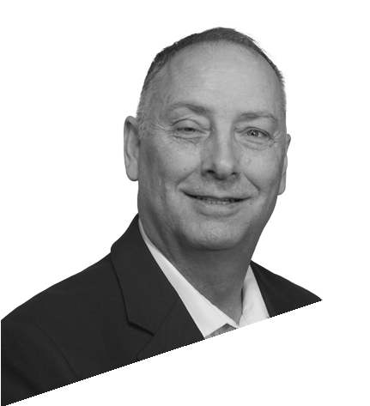
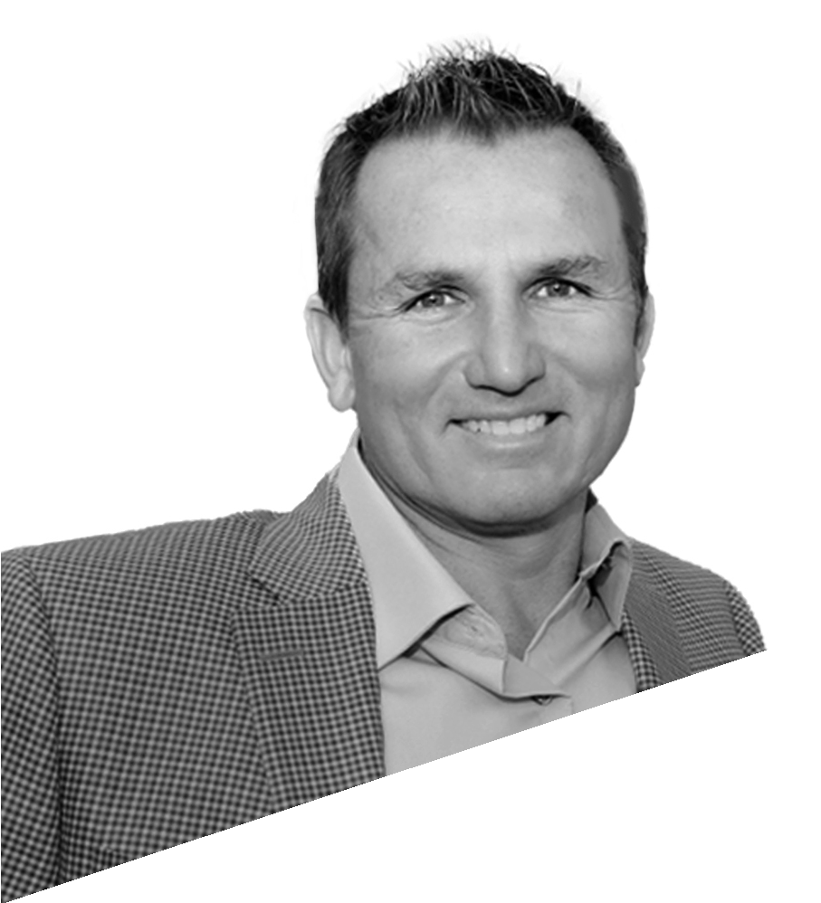
NATIONAL EXECUTIVE TEAM
RANDY CHRISTENSEN
PRESIDENT & CEO
rchristensen@nowcfo.com
JIM BENNETT
CHAIRMAN & FOUNDER
jbennett@nowcfo.com
CHRISTINA JACKSON
CHIEF PEOPLE OFFICER
christina.jackson@nowcfo.com
JEFF GIBBS
CHIEF INFORMATION OFFICER
jgibbs@nowcfo.com
SHAWN DINKELMAN
CHIEF FINANCIAL OFFICER
shawn.dinkelman@nowcfo.com
JASON WELLS
CHIEF AI OFFICER
jason.wells@nowcfo.com

Slide 19
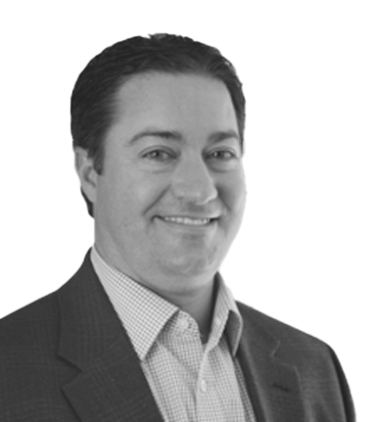
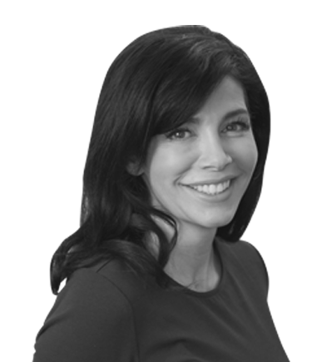
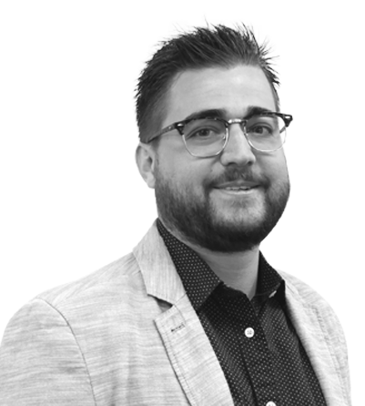
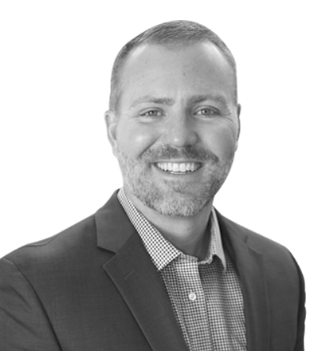
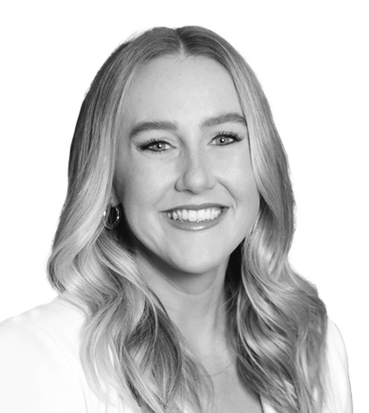
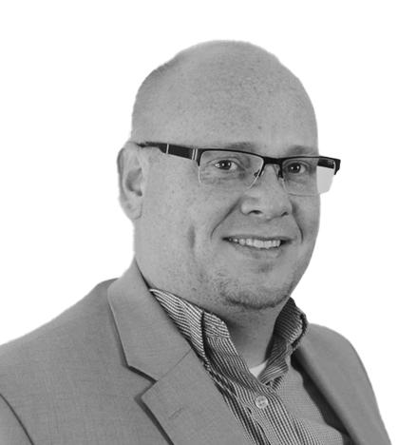
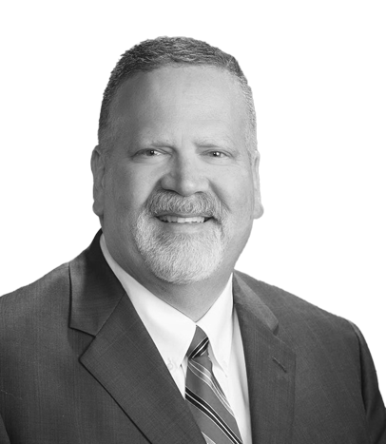
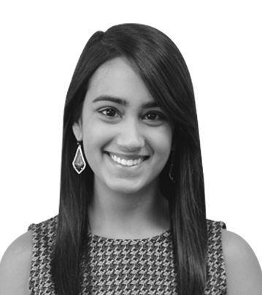
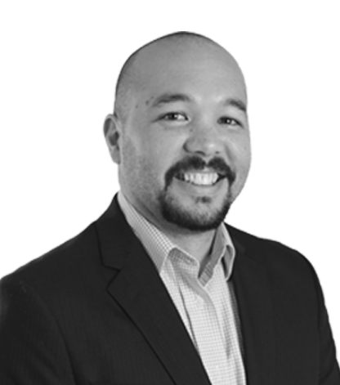
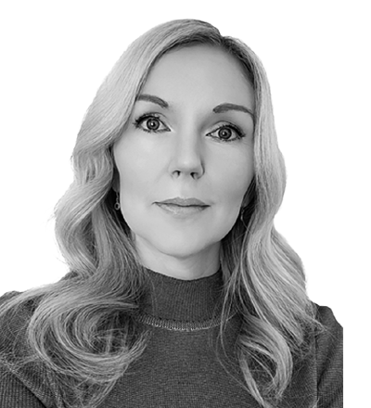
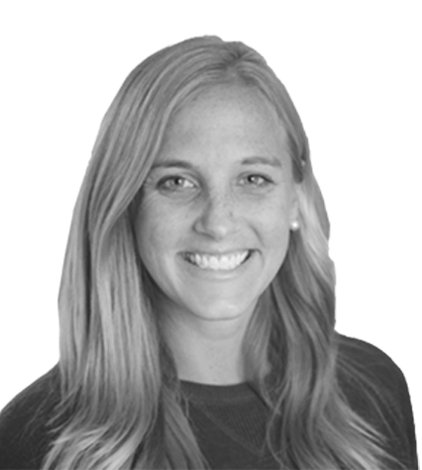
MARKET LEADERSHIP TEAM
REGIONAL PARTNERS:
COLE
DENNARD
REGIONAL PARTNER
Texas | Illinois | Oklahoma 303-981-3473
cdennard@nowcfo.com
MARIANNE
ALLISON
REGIONAL PARTNER
Nevada | Arizona | So. California
702-278-4951
mallison@nowcfo.com
BODI
BRAITHWAITE
REGIONAL PARTNER
Colorado | Utah | Idaho 720-594-9064
bbraithwaite@nowcfo.com
ERIC
PATRICK
REGIONAL PARTNER
North & South Carolina | Florida | Georgia
615-878-1508
epatrick@nowcfo.com
MELISSA
HENKE
REGIONAL PARTNER
Tennessee | Ohio | Indiana 615-651-2671
mhenke@nowcfo.com
PARTNERS:
BRIT
SUMMERILL
PARTNER
Silicon Valley, CA 669-225-0207
bsummerill@nowcfo.com
CHRIS
BADGER
PARTNER
Salt Lake City, UT 801-598-9390
cbadger@nowcfo.com
SANA
SUNDRANI
PARTNER
Dallas, TX | Chicago, IL 214-493-7539
ssundrani@nowcfo.com
BILL
SABLAN
PARTNER
Seattle, WA 206-225-2253
bsablan@nowcfo.com
CHRISTI
CEREGHINO
PARTNER
Phoenix, AZ 702- 533- 6638
christi.cereghino@nowcfo.com
MARIAH
BLOCK
PARTNER
San Diego, CA 858-922-8985
mblock@nowcfo.com

Slide 20
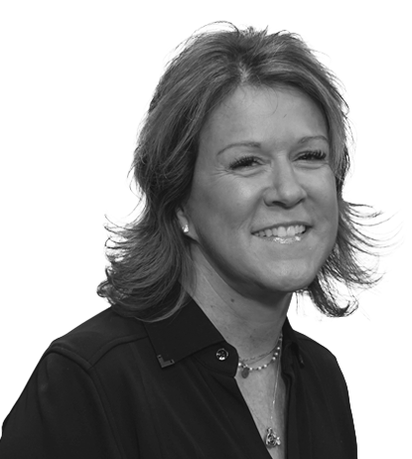
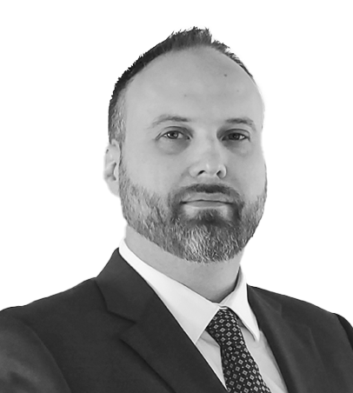
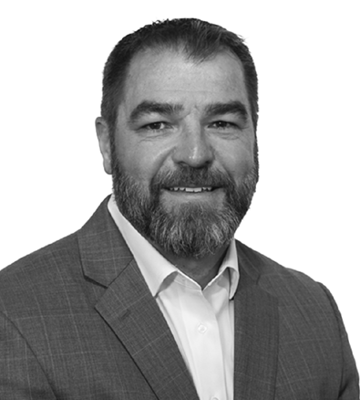
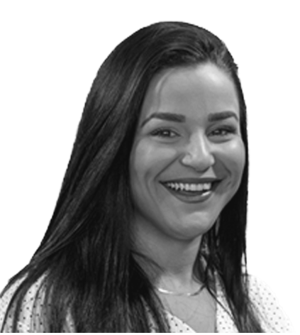
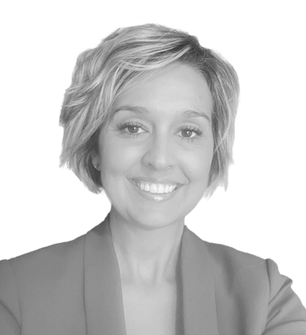
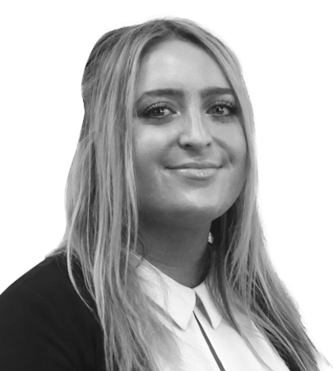
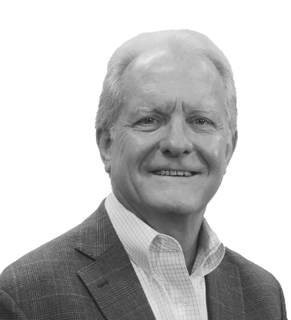
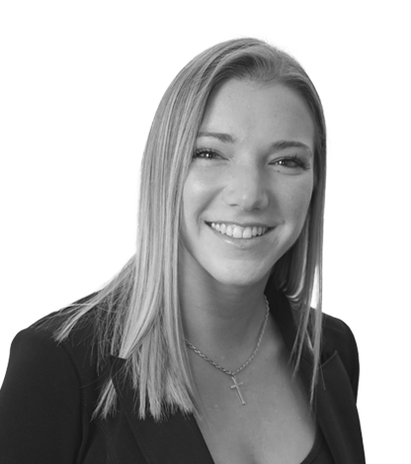
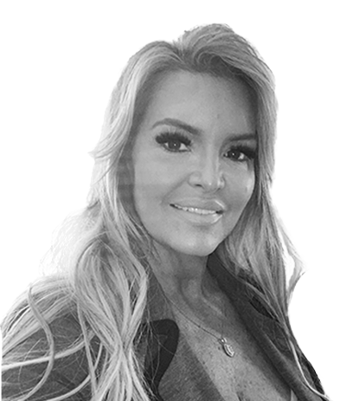
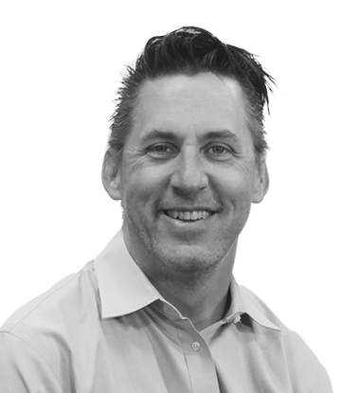
MARKET LEADERSHIP TEAM
AMY
FARROW
PARTNER
Indianapolis, IN 615-762-8175
afarrow@nowcfo.com
NATE
SORENSEN
PARTNER
Salt Lake City, UT 801-616-7378
nsorensen@nowcfo.com
CHRIS
ARAMBULA
PARTNER
Minnesota | Missouri 801-910-5610
chris.arambula@nowcfo.com
MARKET PRESIDENTS:
HILLARY
ROGERS
MARKET PRESIDENT
Tampa, FL 813-344-9405
hrogers@nowcfo.com
TANESHA
BUNDY
MARKET PRESIDENT
Oklahoma City, OK 580-239-0436
tanesha.bundy@nowcfo.com
CAROLINE
HÉBERT
MARKET PRESIDENT
Denver, CO 720-584-1104
chebert@nowcfo.com
SAM
HOWELL
MARKET PRESIDENT
Orlando, FL 801-750-4364
samuel.howell@nowcfo.com
GEORGE
STEPHENS
MARKET PRESIDENT
Austin, TX 512-970-1432
george.stephens@nowcfo.com
RACHEL
DURKOT
MARKET PRESIDENT
Phoenix, AZ 602-370-8662
rdurkot@nowcfo.com
APRIL
DIEMER
MARKET PRESIDENT
Atlanta, GA 470-889-1751
april.diemer@nowcfo.com
SCOTT
CHRISTENSEN
MARKET PRESIDENT
Houston, TX 801-505-8203
scott.christensen@nowcfo.com
WILLIAM
LANGWORTHY
MARKET PRESIDENT
San Bernardino, CA 951-348-8915
wlangworthy@nowcfo.com

Slide 21
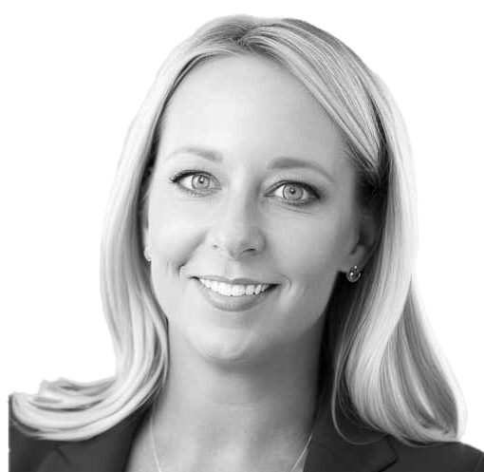
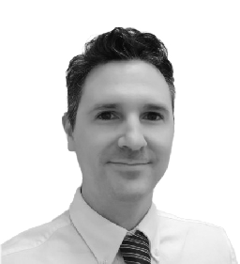
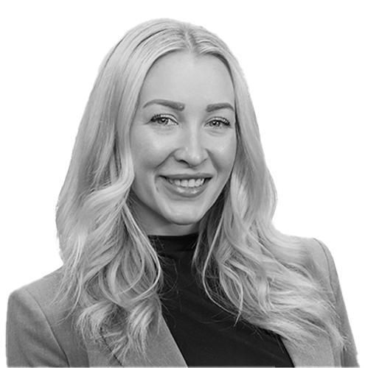
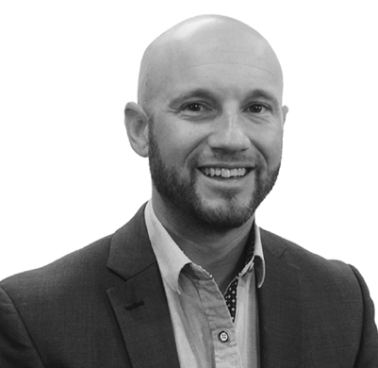
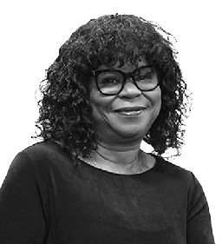
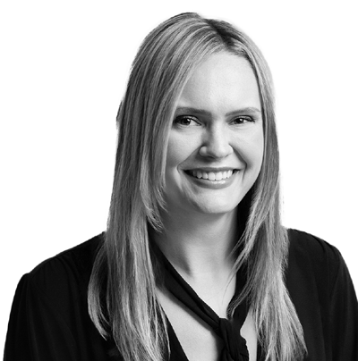
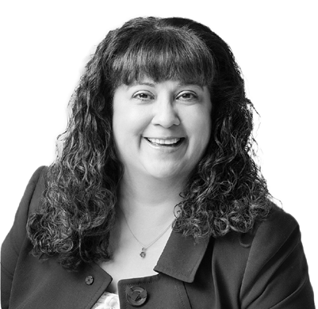
MARKET LEADERSHIP TEAM
DANA
WALLACE
MARKET PRESIDENT
Newport Beach, CA 949-922-6247
dwallace@nowcfo.com
JOSH
GUSTIN
MARKET PRESIDENT
Newport Beach, CA 949-531-0384
jgustin@nowcfo.com
BASIL
CORNELL
MARKET PRESIDENT
Orlando, FL 407-250-7207
bcornell@nowcfo.com
BEN
GODINEZ
MARKET PRESIDENT
Sacramento, CA 916-956-0200
ben.godinez@nowcfo.com
MERCEDES
CRUZ
MARKET PRESIDENT
Las Vegas, NV 702-374-1673
mercedes.cruz@nowcfo.com
TAYLOR
BECKMAN
MARKET PRESIDENT
Portland, OR 971-501-8148
taylor.beckman@nowcfo.com
KIMBERLY
ROCHA
MARKET PRESIDENT
Portland, OR 503-984-7876
krocha@nowcfo.com
NOW CFO - Your Trusted Financial Partner

Slide 23
Experience the Power of Outsourced Financial Expertise
Contact Us For A Free Consultation
nowcfo.com 844-858-6236

Slide 24
Q4 2024

